Slide 1
Thermal Human Temperature Measurement Solution

Slide 2
01
Background and Highlights
02
Economical Solution
03
Wide Area Solution
04
Success Case

Slide 3
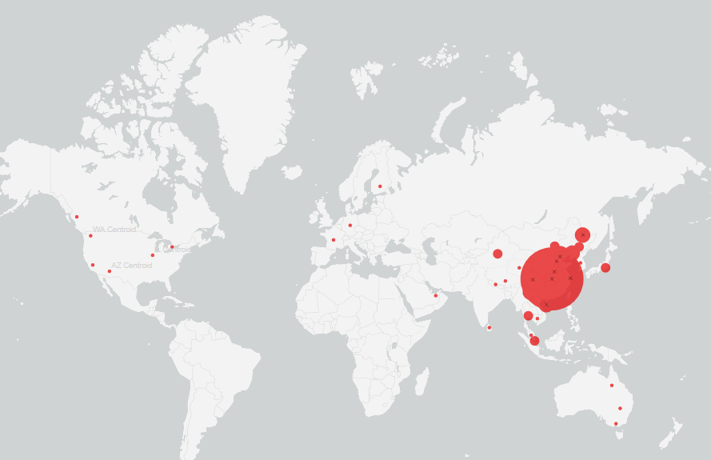
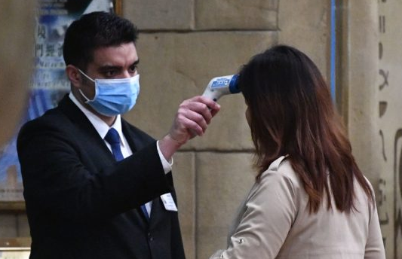
Background
At the end of 2019, a new coronavirus outbreak broke out in Wuhan, China, which is characterized by human-to-human transmission, medical staff infection and community transmission. The disease has spread to China and around the world.

Slide 4
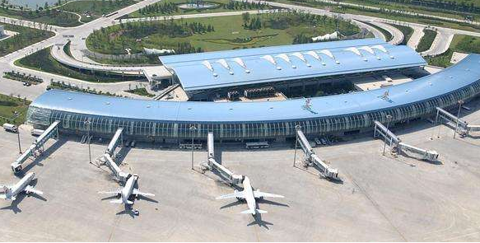
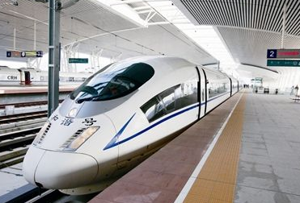
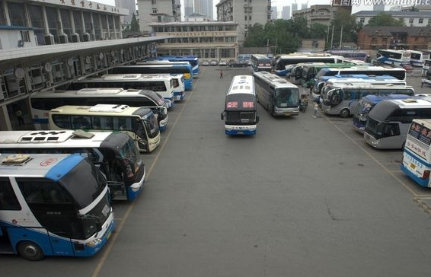
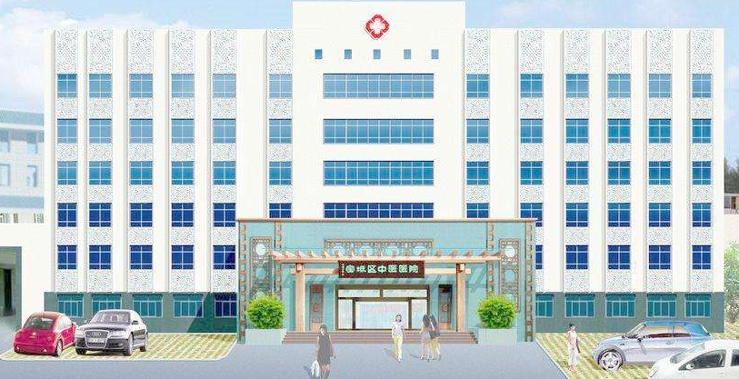
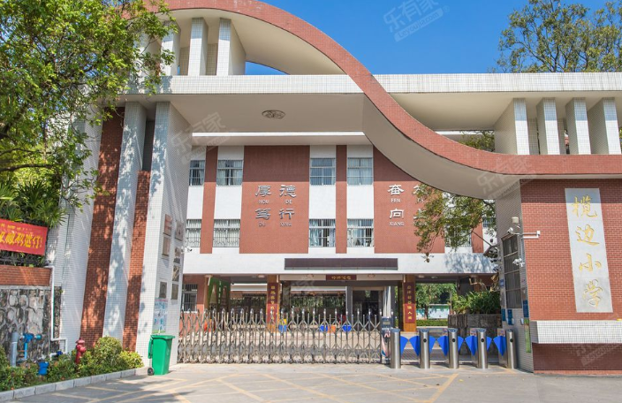
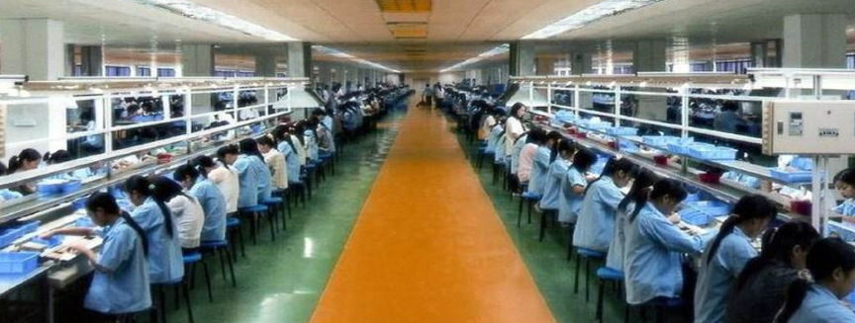
Application Scenarios
Airport
Railway Station
Bus Station
Ferry
Hospital
School
Manufacture
Retail Store

Slide 5
Status Analysis
Human Temperature Measurement
Key Function
Preliminary Screening
Temperature Record
Low efficiency of thermometer and infrared detection gun
Manual temperature measurement workload, high risk
Manual recording is inefficient
Personnel information collection is difficult
Current Status
Non-contact automatic temperature measurement
Accurate, fast and multi-person detection
Record abnormal temperature information automatically
Collect abnormal personnel portrait automatically
Requirement

Slide 6
Highlights
Accurate
Efficient
Manageable
±0.3℃（with blackbody）
Applied to small scenes such as entrances and exits
Large scenes such as airports and railway stations with dense personnel
Non - contact temperature detection, quick screening
Wide coverage and multiple person detection
Easy to use and deploy
Real-time fever alarm
Automatic early warning mechanism, reduce labor cost and risk of cross-infection
Realize the historical data backtracking, data analysis and so on

Slide 7
01
Background and Highlights
02
Economical Solution
03
Wide Area Solution
04
Success Case

Slide 8
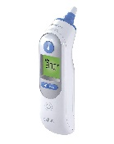
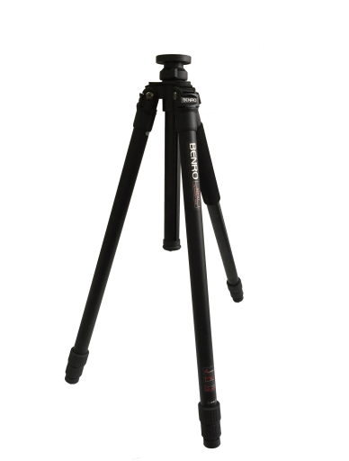
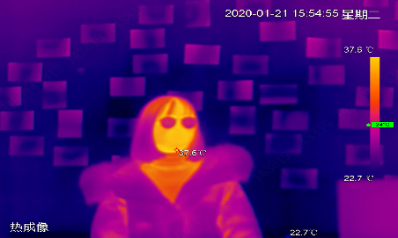
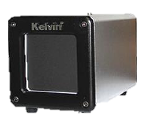
Solution
Temperature Measurement Area
Isolation area
Process
Non-contact temperature measurement
Thermal camera
Black body
Manual review
Abnormal confirmed
Passage
Abnormal temperature, automatic alarm
Activate emergency plan
Topology
Black Body
TPC-SD8421-T
IVSS 7X
DSS Pro
DSS Client
Notes:
加黑体，道闸加视场角

Slide 9
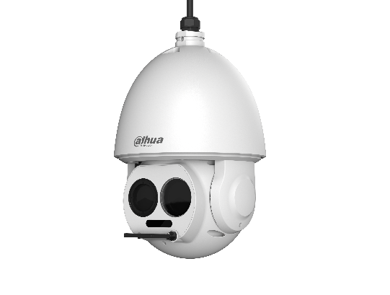
Products
Thermal Network Hybrid Speed Dome Camera
DH-TPC-SD8421-T
Blackbody
DH-TPC-HBB1
Vox uncooled focal plane detector
Resolution ：400*300 Spectral Range ：8~14 μm Thermal lens ：7.5mm/13mm NETD ：<40 mK Visible ：1/2.8“CMOS，1080P Visible lens ：4.95~198mm, 40X
IR distance：100m Temperature measurement range ：30℃～45℃，
Temperature measurement accuracy ：
±0.3℃， with blackbody
Working temperature ：40.0℃（ environment temperature +5.0℃~ 50.0℃）
Temperature resolution ：0.1℃
Temperature measurement accuracy ：±0.2℃（Single point）
Temperature stability ：±( 0.1～0.2 )℃/30min
Effective emissivity ：0.97±0.02
Power：220VAC 50Hz
Ambient temperature and humidity ：0~40℃/ ≤80%RH

Slide 10
Product Selection
Thermal
Black Body
IVS Server
Platform
DH-TPC-SD8421-T
DH-TPC-HBB1
IVSS7008-1I
DSS Pro
Vox uncooled focal plane detector
Resolution ：400*300 Spectral Range ：8~14 μm Thermal lens ：7.5mm/13mm NETD ：<40 mK Temperature measurement range ：30℃～45℃，
Temperature measurement accuracy ：
±0.3℃， with blackbody
Working temperature ：40.0℃（ environment temperature +5.0℃~ 50.0℃）
Temperature resolution ：0.1℃
Temperature measurement accuracy ：±0.2℃（Single point）
Temperature stability ：±( 0.1～0.2 )℃/30min
Effective emissivity ：0.97±0.02
Max 400Mbps incoming bandwidth
Up to 8-channel face recognition with normal IPC
> Up to 20-channel face recognition with face detection IPC
> Up to 50 face databases with 300,000 face pictures in total
Live video monitoring
AI Search: Searching by event, or face pictures
User friendly interfaces
Easy to use and deploy
Temperature alarm pop up automatically

Slide 11
01
Background and Highlights
02
Economical Solution
03
Wide Area Solution
04
Success Case

Slide 12
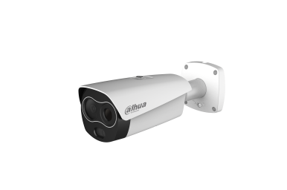
Solution and Progress
Process
Non-contact temperature measurement
Manual review
Abnormal confirmed
Activate emergency plan
Λύση Dahua
Black Body
DH-TPC-BF3221-T
IVSS 7X
DSS Pro
DSS Client
Notes:
加黑体，道闸加视场角

Slide 13
Main Products
Thermal Network Value Hybrid Bullet Camera(Lite series)
DH-TPC-BF3221-T
Blackbody
DH-TPC-HBB1
Vox uncooled focal plane detector
Resolution：256*192 Spectral Range：8μm~14μm Thermal lens：3.5mm/7mm（optional） NETD：<50 mK Visible：1/2.8“CMOS，1080P Visible lens：4mm/8mm(optional) Alarm：Built-in white light warning light, horn
Temperature measurement range：30℃～45℃，
Temperature measurement accuracy ：±0.3℃，with blackbody
±1℃，without blackbody
Working temperature ：40.0℃（ environment temperature +5.0℃~ 50.0℃）
Temperature resolution ：0.1℃
Temperature measurement accuracy ：±0.2℃（Single point）
Temperature stability ：±( 0.1～0.2 )℃/30min
Effective emissivity ：0.97±0.02
Power：220VAC 50Hz
Ambient temperature and humidity ：0~40℃/ ≤80%RH

Slide 14
Product Selection
Thermal
Black Body
IVS Server
Platform
DH-TPC-BF3221-T
DH-TPC-HBB1
IVSS7008-1I
DSS Pro
Resolution：256*192 Spectral Range：8μm~14μm Thermal lens：3.5mm/7mm（optional） NETD：<50 mK Alarm：Built-in white light warning light, horn
Temperature measurement range：30℃～45℃，
Temperature measurement accuracy ：±0.3℃，with blackbody
±1℃，without blackbody
Working temperature ：40.0℃（ environment temperature +5.0℃~ 50.0℃）
Temperature resolution ：0.1℃
Temperature measurement accuracy ：±0.2℃（Single point）
Temperature stability ：±( 0.1～0.2 )℃/30min
Effective emissivity ：0.97±0.02
Max 400Mbps incoming bandwidth
Up to 8-channel face recognition with normal IPC
> Up to 20-channel face recognition with face detection IPC
> Up to 50 face databases with 300,000 face pictures in total
Live video monitoring
AI Search: Searching by event, or face pictures
User friendly interfaces
Easy to use and deploy
Temperature alarm pop up automatically

Slide 15
01
Background and Highlights
02
Economical Solution
03
Wide Area Solution
04
Success Case

Slide 16
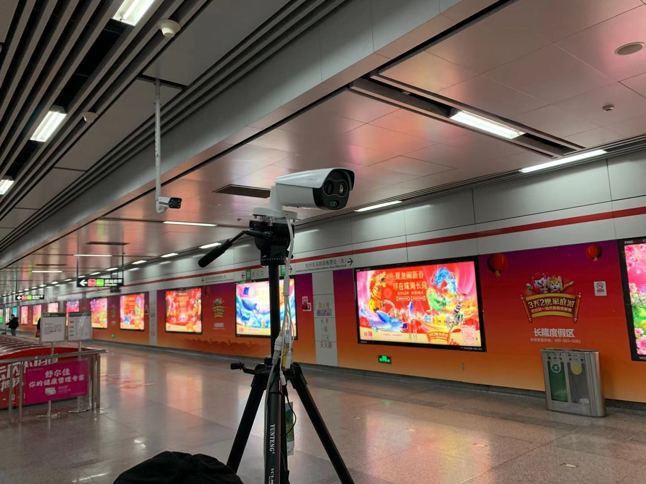
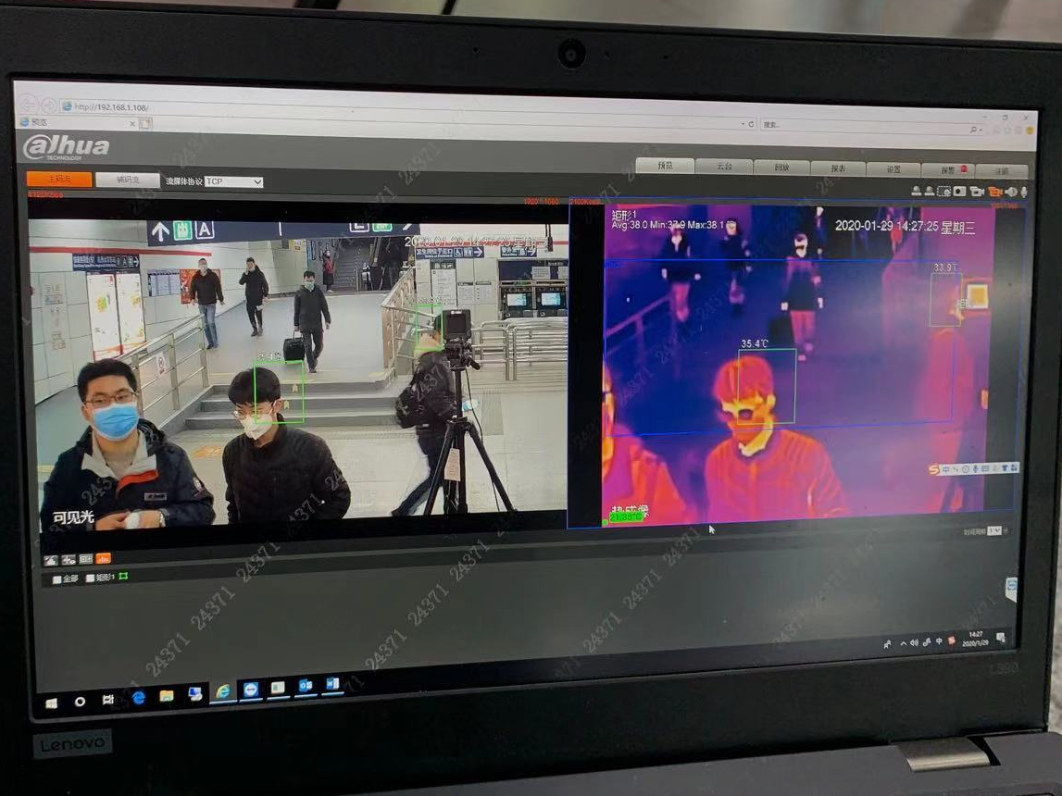
Success Case | Hangzhou Metro
Hangzhou Metro
Hangzhou metro line 1 adopts Dahua thermal human temperature measurement solution at Hangzhou east railway station, one of the largest transportation hubs in Asia, realizing remote non-contact temperature measurement with high temperature measurement accuracy (±0.3°).

Slide 17
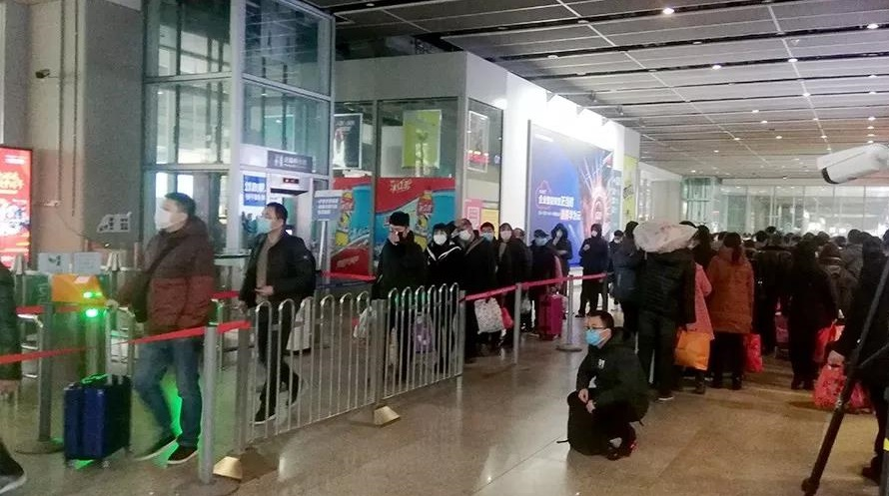
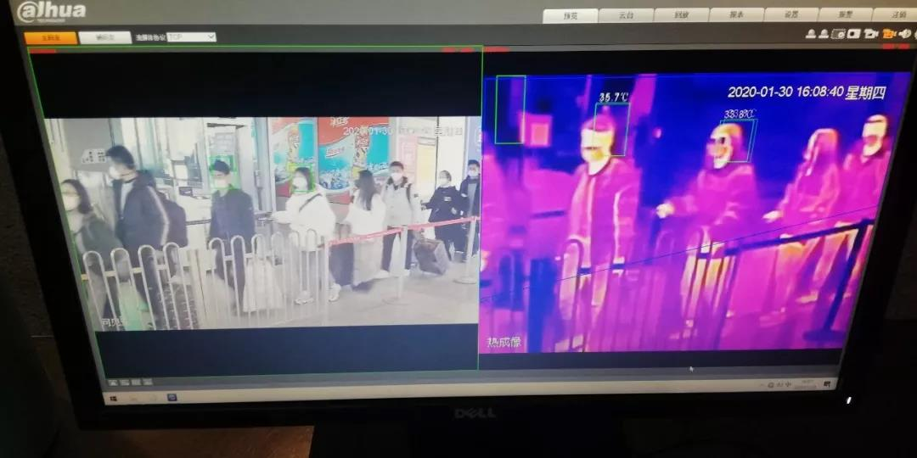
Success Case | Shanghai Railway Station
Shanghai Railway Station
Dahua thermal human temperature measurement solution helps Shanghai railway station, one of the busiest railway station in the world, to realize rapid human body temperature measurement with dense crowds and find people with abnormal body temperature timely.

